Slide 1
Patient Monitoring System
23CSE304
Embedded Systems
Case Study
Team Members:
Abhinav G - CB.SC.U4CSE23201
Darun R G - CB.SC.U4CSE23215
Pradeep S - CB.SC.U4CSE23232
Sathya Roopan M - CB.SC.U4CSE23256

Slide 2
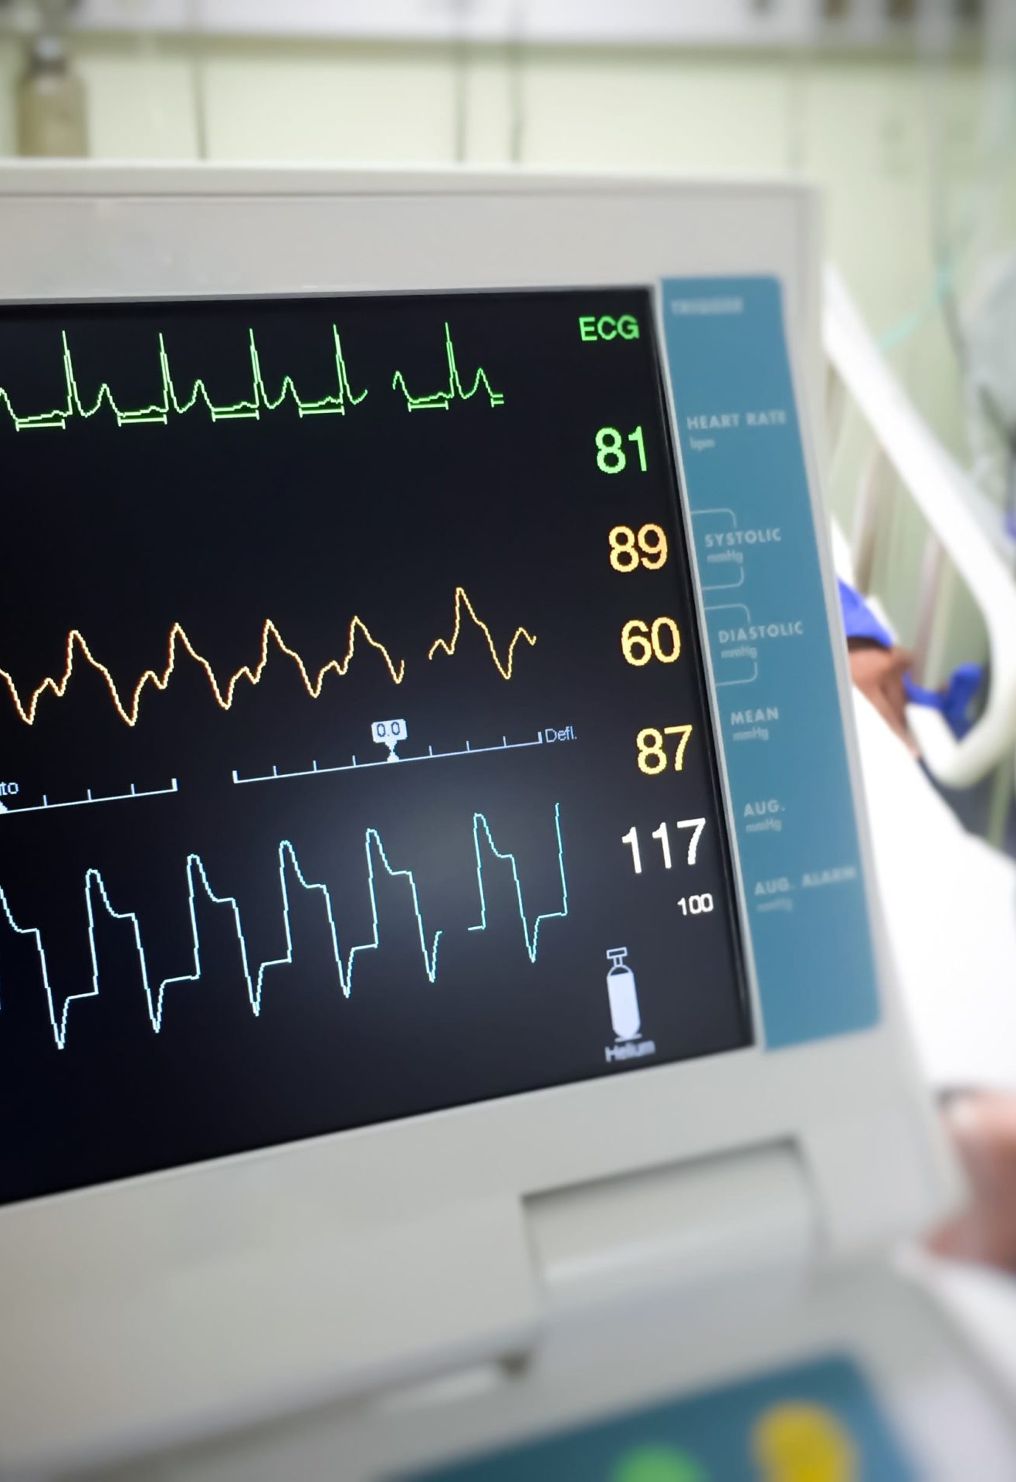
Problem Statement:
Traditional health monitoring often requires patients to visit hospitals or clinics for basic vitals measurement like heart rate, SpO₂, and body temperature. This creates difficulties for patients in remote areas, elderly people, or those requiring continuous monitoring, as frequent hospital visits are inconvenient and costly.
There is a need for a low-cost, portable, and real-time patient health monitoring system that can:- Continuously record vital signs such as pulse rate (BPM), blood oxygen saturation (SpO₂), and body temperature.

Slide 3
Components Used:
(i) STM32F401 (Black Pill Board & Debugger),
(ii) MAX30102 Sensor (for Pulse rate & SpO2 saturation reading),
(iii) LM35 Sensor (for measuring the body temperature),
(iv) TTL Convertor (for transmitting/receiving data between PC and Micro-Controller via UART)
(v) HC05 bluetooth module (to send the readings to device),
(vi) Led, Buzzer, Jumper Wire(s), Push Button, LCD Display & Bread board.
Solution:
We propose a real-time, portable patient health monitoring system built on the >STM32F401 microcontroller, designed to continuously measure and display key vital signs.
> Tracks pulse rate (BPM), SpO₂ levels, and body temperature in real time.
> Uses LEDs and a buzzer to indicate abnormal readings for quick response.
> Shows live health data on a 16x2 LCD screen for easy understanding by caregivers or patients.
> Utilizes NVIC (Nested Vectored Interrupt Controller) to manage alerts smoothly.

Slide 4
Plan of Action:
Initial Setup: Assemble basic circuit on a breadboard. Using Keil µVision5 for firmware development.
Data Acquisition: Initialize MAX30102 sensor and read pulse & SpO₂ values via I²C. Sample temperature from LM35 using ADC.
Data Processing: Convert ADC voltage from LM35 to temperature (°C\°F).Extract pulse rate and SpO₂ from MAX30102 data. Compare readings to pre-defined normal ranges.
Output and Alerts: Display temperature, heart rate, and SpO₂ on the LCD/PC. If abnormal values are detected, Turn ON LED and buzzer as an alert. Send readings to laptop/mobile via Bluetooth or UART.

Slide 5
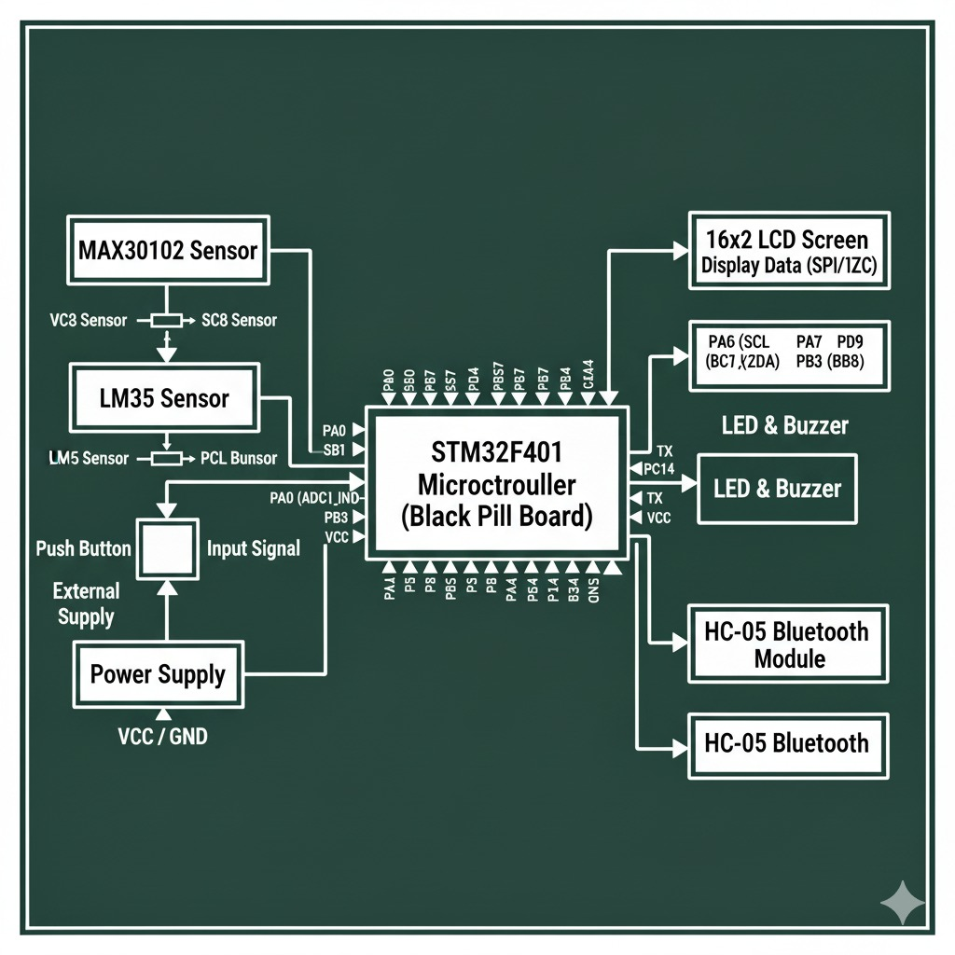
Block Diagram:

